Slide 1

Web hosting Static File in IBM Cloud
Project by:-
(Archana Kumari)
Guide by:-Ms Arpita Roy

Slide 2
CONTENT
 | Title
1 | Problem Statement
2 | Project Overview
3 | Why We need this?
4 | How it will help people?
5 | Solution
6 | How it’s unique
7 | Modeling
8 | Result

Slide 3
Problem Statement
Host static files on IBM Cloud using IBM Cloud Object Storage. Create a storage instance, upload files to a bucket, note API key and endpoint. Deploy a simple web app on IBM Cloud Foundry with the static file buildpack. Set environment variables for Object Storage credentials, restage the app. Access your hosted static files.

Slide 4
Project overview
Host static files on IBM Cloud using Object Storage. Create a storage instance, upload files, deploy a web app on Cloud Foundry with Object Storage integration. Access files via the deployed app's URL.

Slide 5
Why we need this?
Efficiently host static files on IBM Cloud to ensure reliable, scalable, and globally accessible storage, optimizing web application performance and user experience.

Slide 6
How it will help people?
Hosting static files on IBM Cloud ensures fast, reliable, and globally accessible content delivery, enhancing user experience, and optimizing web application performance. It provides a scalable solution with robust storage infrastructure, benefiting developers and businesses in delivering content seamlessly to end-users.

Slide 7
Our solution
IBM Cloud Object Storage:
Utilize IBM Cloud Object Storage for secure and scalable file storage.
Bucket Creation:
Create a bucket in IBM Cloud Object Storage to organize and store static files.
File Upload:
Upload static files to the designated bucket, ensuring proper organization and accessibility.
Endpoint and API Key:
Obtain the Object Storage instance's endpoint URL and API key for authentication.
Web Server Deployment (Optional):
Deploy a web server (e.g., using IBM Cloud Foundry) for serving static files with appropriate buildpacks.
Environment Configuration:
Set environment variables on the web server for Object Storage credentials, including API key and endpoint.
.

Slide 8
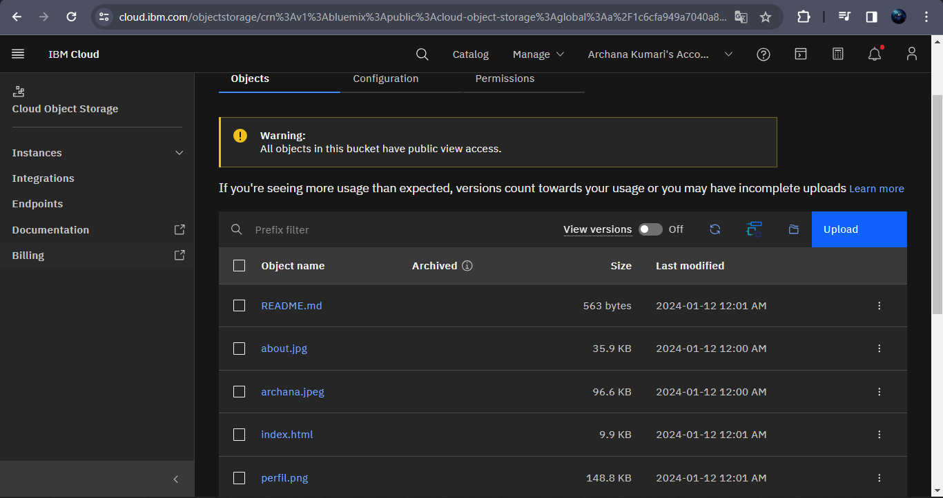
Our solution

Slide 9
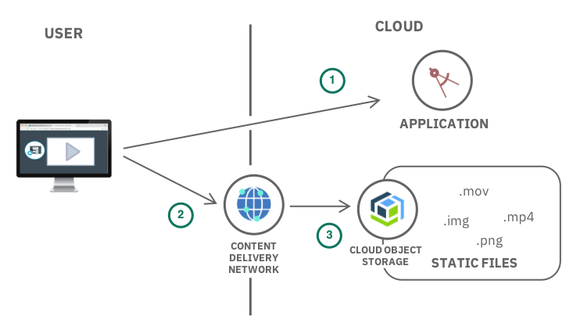
Modeling(Analysis model)

Slide 10

Result
This results in a performant, secure, and scalable infrastructure for hosting static files, supporting diverse use cases from simple websites to complex web applications and web hosting in ibm cloud object storage projects.
https://webhosting.s3.jp-tok.cloud-object-storage.appdomain.cloud/index.html

Slide 11
Thank
you

